Slide 1
An introduction to Raspberry Pi & Python Programming
Mr Martin Thong
Mr Wong Kim Siong
Robotics Connection Pte Ltd
Updated on August 2016

Slide 2
Course objectives:
Be familiar with the Raspberry Pi Hardware
Learn basic python commands
Understand circuit diagrams and assemble them
Use python to control RPi GPIOs
Use RPi to control a robot car, GoPiGo

Slide 3
6-lesson Agenda
Lesson 1
Introduction to Raspberry Pi hardware
Setting up the Raspberry Pi
Introduction to Python Programming
Print statements, do calculations, create variables, understanding different data types
Introduction to GPIO Pins
Programming LEDs to ON/OFF
Lesson 2
Introduction to Python Programming
Getting user input, decision making, using loops
Programming LEDs to blink

Slide 4
Raspberry Pi
Is a credit sized computer that runs on linux
Specifications of RPi 3
A 1.2GHz 64-bit quad-core ARMv8 CPU
802.11n Wireless LAN
Bluetooth 4.1
Bluetooth Low Energy (BLE)
1 GB RAM
4USB ports
40 GPIO pins
Full HDMI port
Ethernet port
Combined 3.5mm audio jack and composite video
Camera interface (CSI)
Display interface (DSI)
Micro SD card slot
VideoCore IV 3D graphics core

Slide 5
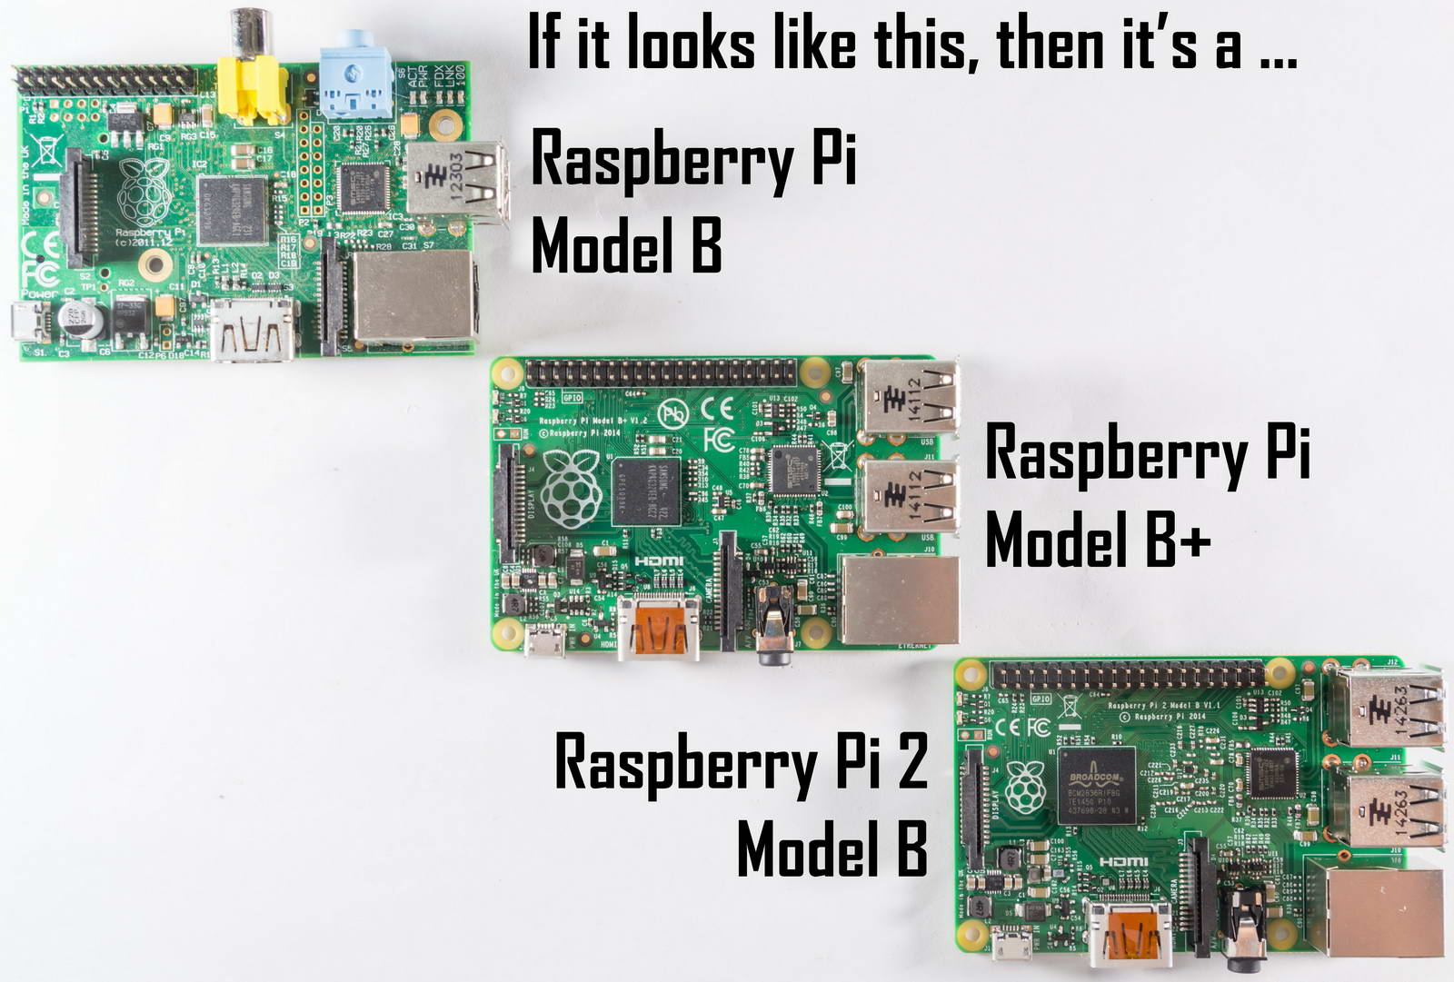
Different versions of Raspberry Pi

Slide 6
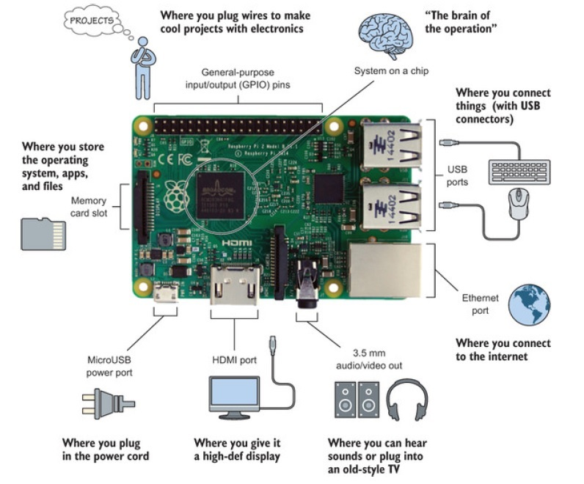
The Top View of RPi

Slide 7
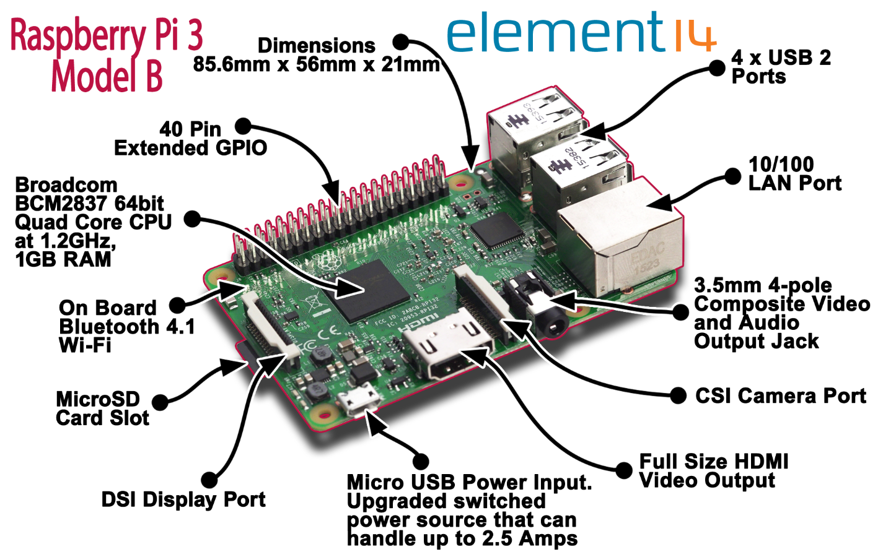
Raspberry Pi 3 Model B

Slide 8
What can I do with RPi?
Use as a secondary / back-up PC
Do word-processing & spreadsheets
Running a multi-media center
Learn Programming (eg. Python)
Use as a micro-controller (eg. To control a robot)
Create your own projects

Slide 9
Setting up the SD card
Go to the link below to download the SD Card formatter 4.0 software.
https://www.sdcard.org/downloads/formatter_4/
Use it to format an SD card which is 4GB or larger as FAT
Go to the link below to download the latest NOOBS zip file
https://www.raspberrypi.org/downloads/
(Optional) Go to the link below to download the hashcheck software and install it.
http://code.kliu.org/hashcheck/
You can use it to check whether the file you have download is corrupted.
Right-click on the file you have downloaded and look under checksums.
Extract the files from the NOOBS zip file and copy onto the SD card.

Slide 10
Back-up your SD card
Go to the link below to download the WIN32Imager software.
https://sourceforge.net/projects/win32diskimager/
Use this software to backup your SD card as often as needed.

Slide 11
Setting up the hardware
Put your RPi in a case to protect it from accidental damage
Insert your SD card into the memory card slot
Connect your keyboard and mouse using the USB ports
Connect your monitor using the HDMI port
Plug in your power cord using the power port

Slide 12
Boot-up your RPi
On first boot, select Raspbian
Default userid: pi
Default password: raspberry
To start Graphical User Interface, type startx
To always start in the Graphic User Interface (GUI)
type sudo raspi-config
Go to Boot Options
Select Desktop Autologin

Slide 13
Personalise your RPi
Click on Menu, Preferences, Raspberry Pi Configuration
Under System
Change your password
Change your hostname
Under Localisation
Set Locale, Timezone, Keyboard and Wifi country

Slide 14
Add/delete new user
Launch Terminal (Command Line Shell)
To add a user, type sudo adduser martin
You will be prompted for a password for user martin. Leave blank for no password.
To disable a user, type sudo deluser martin
To delete all traces of user, type
sudo deluser –remove-all martin

Slide 15
Why Python?
Simple yet elegant (very clear and readable syntax)
Excellent for beginners, yet superb for experts
Cross Platforms (Windows, Mac, Linux etc.)
Open source (Free)
Skills learned will be portable to different programming languages (e.g. Java, C++, etc)
Preferred programming language by Raspberry Pi

Slide 16

Getting Started with Python
We will be using Geany to learn python v3:
Print messages
Using python to do calculations
Create variables
Getting user input
If … else … statements
while loop and for loop

Slide 17
Start Geany
Look for the icon on the Desktop and click on it to open.
Click “New” and then “save as”
Create a new folder on Desktop using your name. You will be saving all your python files inside.
Name of file : “examples.py”
Press save to save your file.

Slide 18
Print messages
Type print (“Hello World”)
Press the execute button or F5 to run your program
Congratulations!!! You have created your first python program.

Slide 19
Try this!
print (“My name is <your name>”)
print (“ I am <your height> m tall.”)
print (“I weigh <your weight> kg.”)
print (“I work at <your workplace>”)
Press the execute button or F5 to run your program
Try and type your own messages
Notes:
Run a few negative examples: Print , without quotes, different quotes.

Slide 20

Do calculations
print (3 + 5)
print (18 – 2)
print (12 * 18)
print (3 ** 2)
print (10 / 3)
print (10//3)
print (10 % 3)
What about more complex calculations?
Notes:
** - to the power of, / - divide by, returns decimal, // - floor division, returns the integer, % - modulus, returns the remainder

Slide 21
Precedence of Operators
Operator | Description
() | Brackets
** | Exponentiation
* / % | Multiply, divide, modulus
+ – | Addition and subtraction
Do first
Do last
Hence, 10 – 3 * 2 and (10 – 3) * 2 will give different answers. Try it!
10 – 3 * 2 = _____
(10 – 3) * 2 = _____

Slide 22
Create Variables
A variable is like a box. It can keep things inside.
Examples:
msg = “Good morning!”
ans = 3+5
print the variable to see what is stored inside
print (msg)
print (ans)
msg
ans
“Good morning!”
8

Slide 23
Data Types
Each variable can only store 1 data type.
The 4 main data types are:
Integer – represents whole numbers
Float – represents numbers with decimal points
String – represents sets of characters in between single or double quotes
Boolean – represents one of two values: True, False

Slide 24
Can you identify the data type?
Integer
Float
String
Boolean
 | Value | Data Type
1. | True
2. | “Programming”
3. | “True”
4. | 101
5. | False
6. | 123.456
7. | “123.456”
8. | “^_^”
9. | “SOS - 999”
10. | “Testing 1 2 3…”

Slide 25
Variable names
Variable names can be made up of letters, numbers and the underscore character (_)
They cannot start with a number.
Variable names should be meaningful. It should represent what you want to store inside.
Eg. age = 14, my_height = 1.5,
scienceGrade = “A”

Slide 26
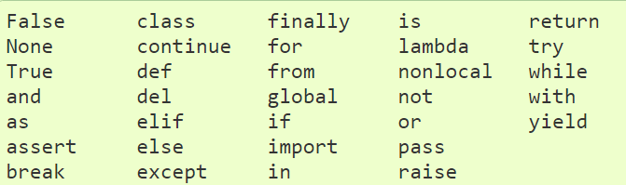
Reserved Python Keywords
These words cannot be used as variables

Slide 27
Printing string and integers together
Given:
msg = “The time now is ”
time = 1415
print (msg + str(time))
Given:
day = 18, month = “August”, year = 2016
Can you use the given variables to print today’s date as 18th August 2016?

Slide 28
Programming Challenge 1
Create a variable x and assign it a value of 23
Create a variable y and assign it a value of 2.5
Create a variable z and assign it a value of “robots are fun!”
Create a variable flag and assign it a value of False
Create a variable is_weekday and assign it a value of True

Slide 29
Programming Challenge 2
1. Given:
age = 5
print (“age”)
What gets printed?
2. Given:
a = “hazy”
b = “day”
How to print “hazy day” using variable a and b?

Slide 30
Programming Challenge 3
Given:
x = 5
y = 10
How to print the result of multiplication of x and y?
Given:
age1 = 5
age2 = “6”
Using the variables given, how to print 56 and 30?

Slide 31
Programming Challenge 4
Create 4 variables and put your name, workplace, height, weight in it.
Display the following using the variables you have created:
My name is <variable_name>.
I work at <variable_workplace>.
I am <variable_height> m tall.
I weigh <variable_weight> kg.
My BMI is <variable_bmi>.
Notes:
Create another variable bmi.

Slide 32
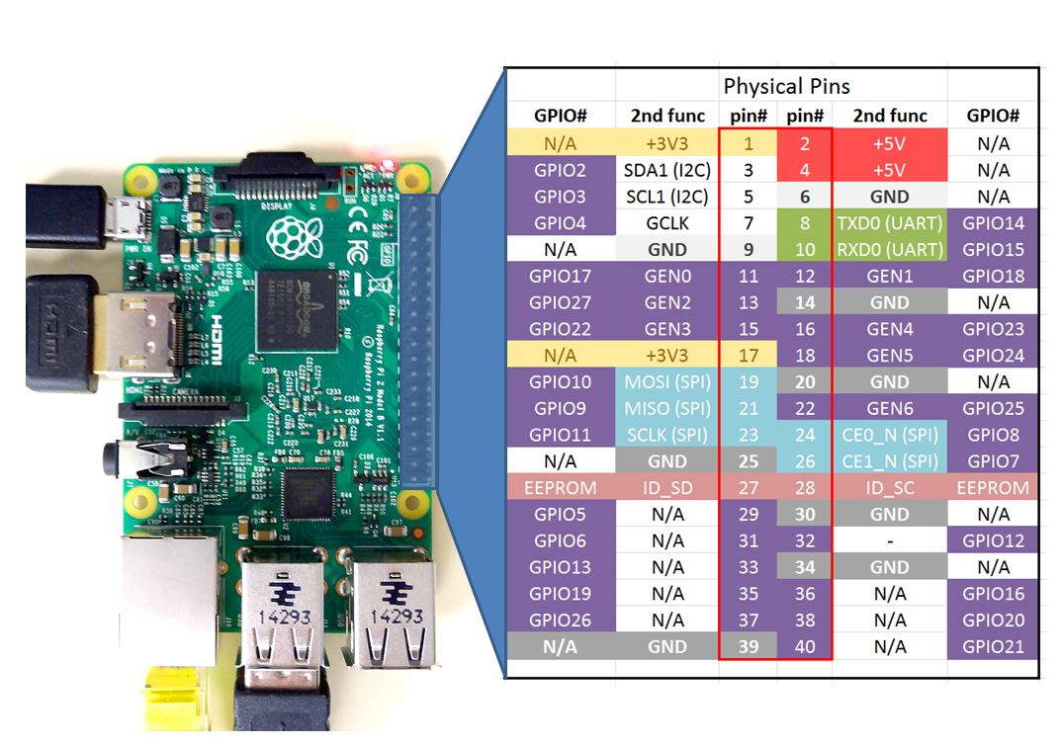
RPi GPIO Pins labels

Slide 33
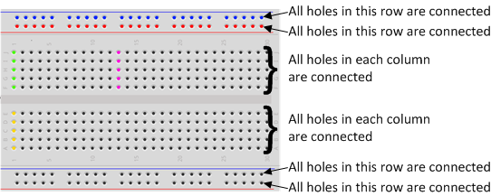
The Breadboard
The breadboard is a way of connecting electronic components to each other without having to solder them together.
The holes on a breadboard are connected in a pattern as shown below.

Slide 34
The LED
LED stands for Light Emitting Diode
It glows when electricity is passed through it
Long leg (anode) always connect to the positive power supply. (V+)
Short leg (cathode) always connect to the negative power supply. (ground)
*LED will not light up if connected the wrong way!

Slide 35
The Resistor
The purpose of the resistor is to limit the current going through the LED.
Passing too high a current through the LED will damage it.

Slide 36
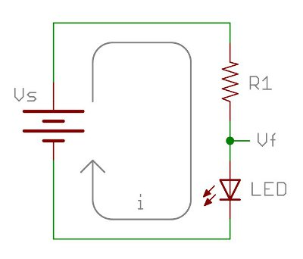
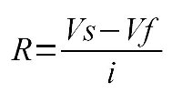

How to calculate resistance?
Assuming we want a 2V
drop across the LED and a
current of 0.01A across it.
By applying Ohm’s law,
= (3.3 – 2.0)V/0.01A
= 130 $Ω$

Slide 37
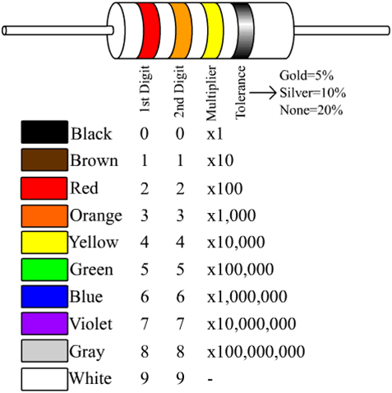
How to read resistor values?

Slide 38
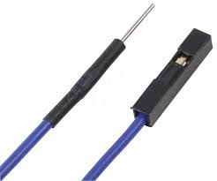
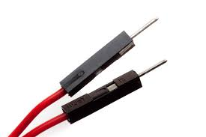
Jumper wires
Jumper wires are used on breadboard to “jump” from one connection to another.
We always use red wires to connect to V+ and black wires to connect to ground.
male-female male-male

Slide 39
Programming an LED ON/OFF
Things we need:
RPi GPIO pins
A breadboard
An LED
A 330 ohm resistor or higher
2 male-female jumper wires
3 male-male jumper wires

Slide 40
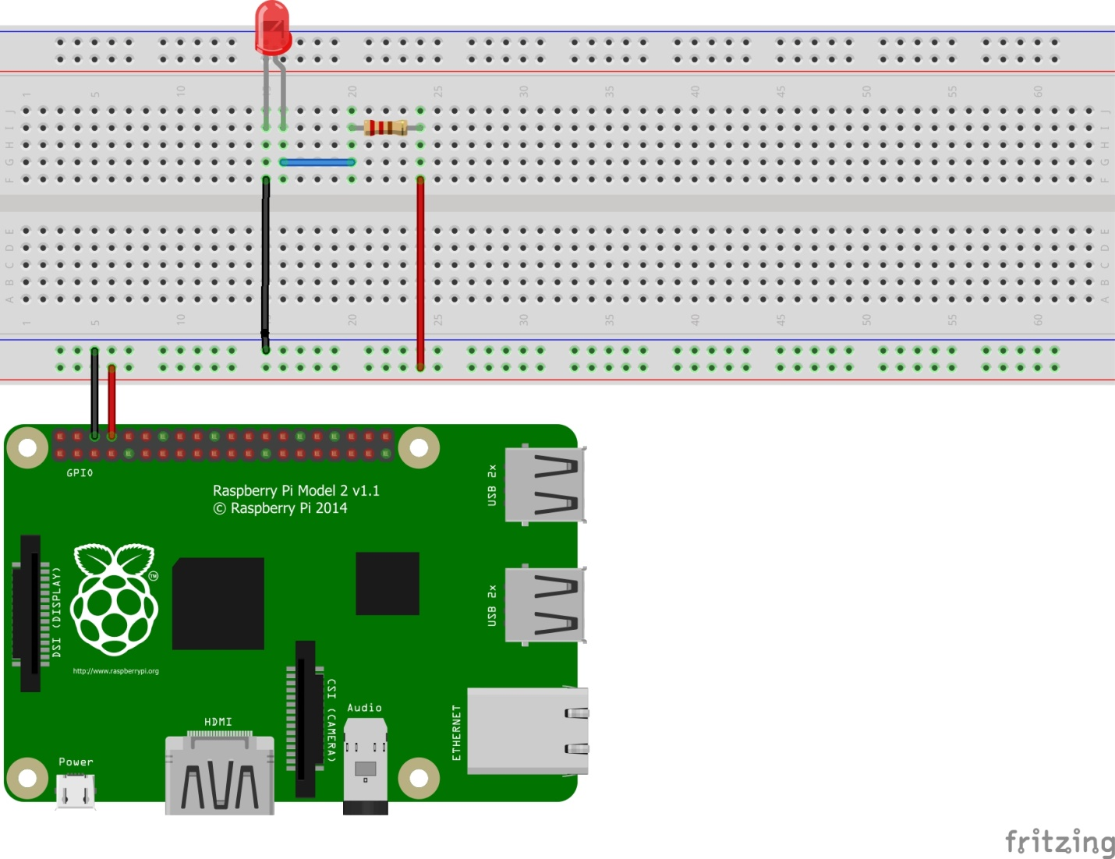
Time to connect our circuit ☺
It is a good practice to turn off your RPi when connecting your GPIO to prevent short-circuit.
Physical pin 6 – ground
Physical pin 8 - output

Slide 41
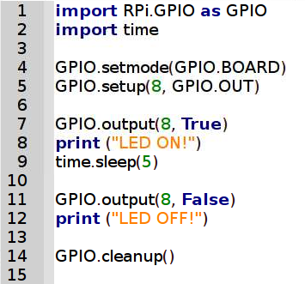
Time to program our LED
Turn on your RPi and launch Geany.
Create a new *.py file and rename it as led.py
Type the following codes:
Did you see the LED turn ON and then OFF?
Did you see the screen print out the words?

Slide 42
RPi Challenge 1
Fix up a similar circuit and connect this LED to pin 10.
Can you ON/OFF this LED using pin 10?
Can you ON/OFF both LED at the same time?
Can you ON/OFF the 1st LED for 3 seconds and then the 2nd LED for 6 seconds?

Slide 43
RPi Challenge 2
Fix up another similar circuit.
Which other GPIO pin can we use?
Can you ON/OFF the 3 LEDs in this sequence, A ->B ->C ->B ->A? LEDs will be on for 2 seconds each.

Slide 44
Getting User Input
Use input() to ask for user input
Eg. name = input(“What is your name?” )
age = input(“What is your age? ”)
Can you print the person’s name and age on the screen?
Sample output:
Your name is Martin. You are 25 years old.
Notes:
Start of lesson 2

Slide 45

Programming Challenge 5
Can you convert speed in m/s to km/h?
Ask the user to key in the speed in m/s and display the speed in km/h.
Sample output:

Slide 46

Programming Challenge 6
Can you write a program that converts time in minutes to time in hours and minutes?
Ask the user to key in the time in hours and display the time in hours and minutes.
Sample output:

Slide 47

Programming Challenge 7
Can you convert time in seconds to time in hours, minutes and seconds?
Ask the user to key in the time in seconds and display the time in hours, minutes and seconds.
Sample output:

Slide 48
Decision Making 1
If a program does the same thing forever, it is boring and not very useful.
Programs must be able to make decisions what to do based on user’s input(s).
Example:
If the user key in the correct answer, add 2 point to the score. If the user key in the wrong answer, minus 1 point to the score.

Slide 49
Decision Making 2
A program will make decision by testing a condition, whether it is True or False.
If it is True, it will execute the codes in the True branch.
If it is False, it will execute the codes in the False branch.

Slide 50
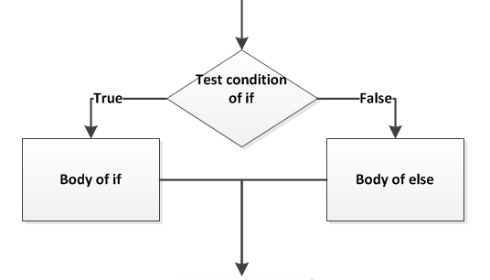
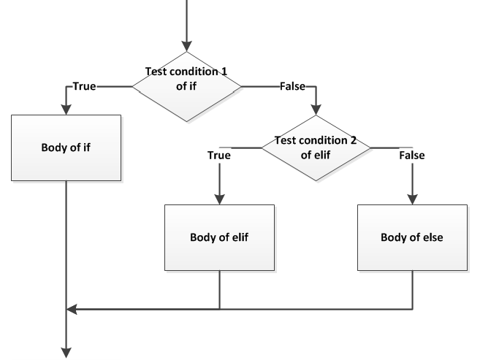
Decision Making 3
if <condition is True>:
<execute the codes in the True branch>
else: #(<condition is False>)
<execute the codes in the False branch>
if <condition 1 is True>:
<execute the codes in the body of If>
elif <condition 2 is True>:
<execute the codes in the body of elif>
else: #(<both condition 1 and 2 are False>)
<execute the codes in the body of else>

Slide 51


Password checker 1
Let’s setup a password checker to give the following sample outputs:

Slide 52
Password checker 2
Step 1: Setup a password.
Step 2: Ask user to enter password.
Step 3: Test the password.
Step 4: print appropriate statements depending on condition.
Sample code:
correct_password = ____________________ #(step 1)
password = ____________________________ #(step 2)
if password == correct_password: #(step 3)
print _______________________________ #(step 4)
else:
print _______________________________ #(step 4)

Slide 53
Conditions in Decision Making
The condition(s) in a test can be expressed through the use of comparison operators.
Expression | What it does
a == b | Evaluates to True when a is equal to b
a != b | Evaluates to True when a is not equal to b
a < b | Evaluates to True when a is less than b
a > b | Evaluates to True when a is more than b
a <= b | Evaluates to True when a is less than or equal to b
a >= b | Evaluates to True when a is more than or equal to b

Slide 54
When to use =, ==?
a = 1 assigns the value 1 to the variable a
a == 1 checks whether the variable a is equal to 1.
It returns True if they are equal
It returns False if they are not equal

Slide 55
Programming Challenge 8
Can you write a program that tells the shopper what is their free gift based on this table?
Tip: Use if…elif…else…
Amount spent | <$100 | >= $100 | >= $500
Free Gift | None | Cap | Shaver

Slide 56



Sample outputs:
This program can only run for one shopper. But there are hundreds of shoppers a day. How can we improve our program?

Slide 57
Repetition
We can write a program that do the same thing over and over again until a condition is satisfied.
We can use a while-loop or a for-loop to achieve this.

Slide 58
A forever while-loop
Example:
status = True
while status == True:
<do these>
Let’s implement the while-loop in our free gift codes.
Set initial condition
Check condition
Ends with a colon
Codes are indented

Slide 59
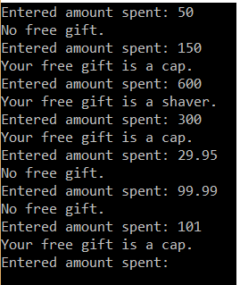
Sample output:

Slide 60
While-loop with exit 1
Example 1:
num = 0
while num < 10:
print (num)
num = num + 1
The above codes will print ___________
Once num = 10, it will exit the while loop.
Can you use a while loop to print 10-1?

Slide 61
While-loop with exit 2
Example 2:
num = 0
while num < 10:
if num == 5:
break
print (num)
num = num + 1
The above codes will print ___________
Once num = 5, it will exit the while loop.
Can you modify your password checker such that the user will keep trying until he gets his password correct?

Slide 62
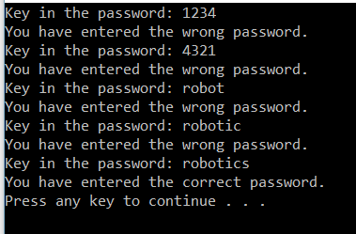
Sample output:

Slide 63
For-loop 1
Example:
for i in range(3):
print (i)
What numbers get printed? ___________
range(x) function is often used with for-loop when we know how many times we want to run the loop repeatedly.
The value of the variable “i” takes on the value 0 → 1→ 2…. each time the loop is repeated.

Slide 64
For-loop 2
What if we want to print numbers from 10…49?
for i in range(10, 50, 1):
print i
What if we want to print 10, 20, ….90, 100?
What if we want to print 100, 95, … 15, 10?
Start
i = 10
End
i = 50-1
Step
+1

Slide 65
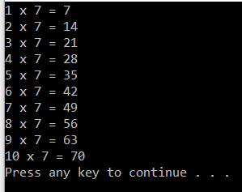
Programming Challenge 9a
Can you print out the 7 times table using 2 lines of code?
Sample output:

Slide 66
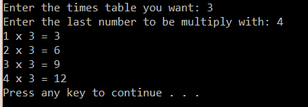
Programming Challenge 9b
Can you let the user decide what times table he wants?
Can you let the user decide what the last number to be multiply with?
Sample output:

Slide 67
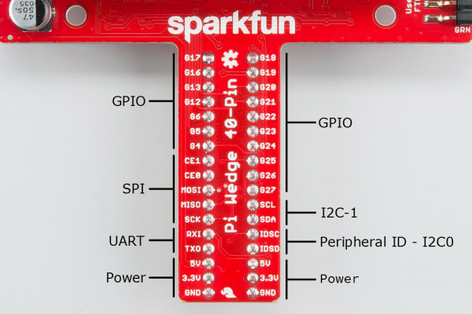
Pi Wedge Pin mapping

Slide 68
Blinking LED 1
We are going to do it by using a Pi Wedge.
Why use a Pi Wedge?
It gives a clearer indication of the pins used
Shut down your RPi
Power up again after you have connected the ribbon to the GPIO.

Slide 69
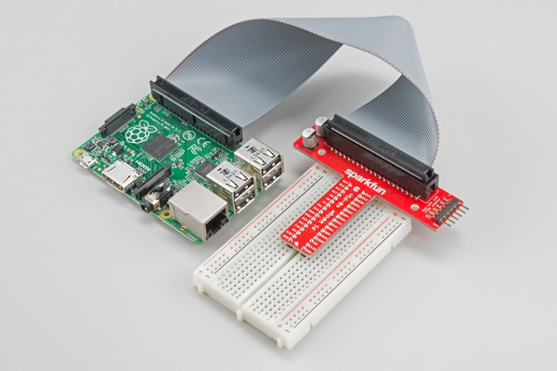
Blinking LED 2
Let’s fixed up the RPi, Pi Wedge, breadboard and the 40-pin ribbon cable as shown.
Red edge of ribbon connected to GPIO pin 1 and 2

Slide 70
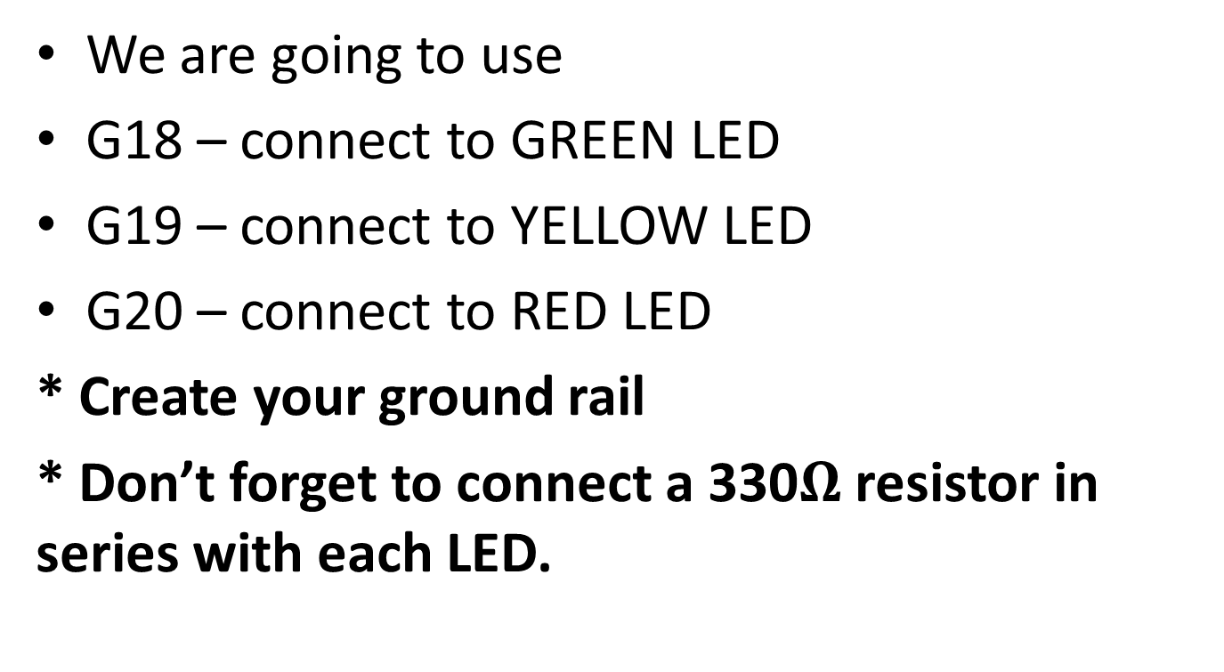
Setting up the circuitry
We are going to use
G18 – connect to GREEN LED
G19 – connect to YELLOW LED
G20 – connect to RED LED
* Create your ground rail
* Don’t forget to connect a 330$Ω$ resistor in series with each LED.

Slide 71
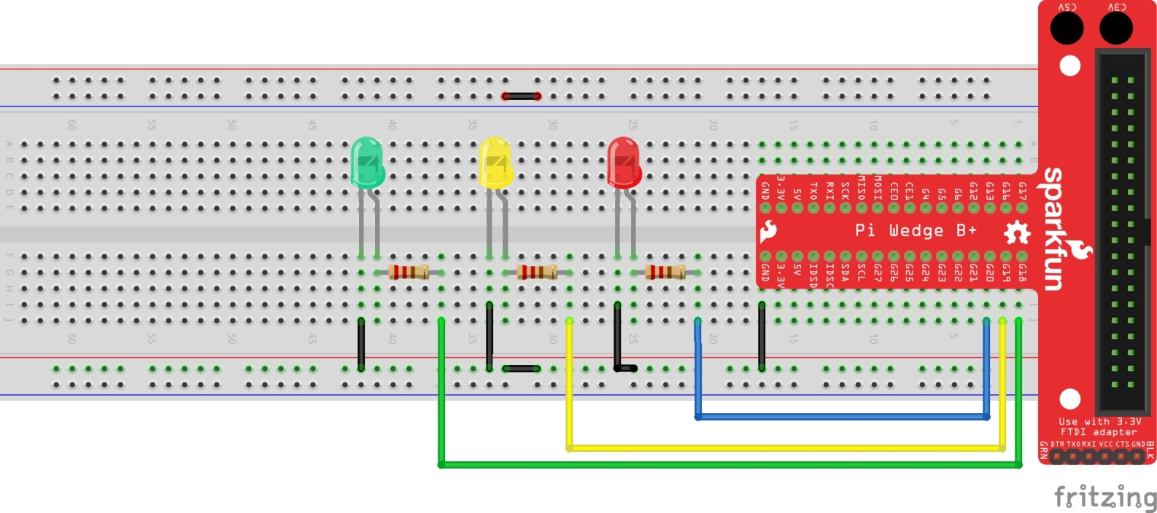
Sample circuit diagram

Slide 72
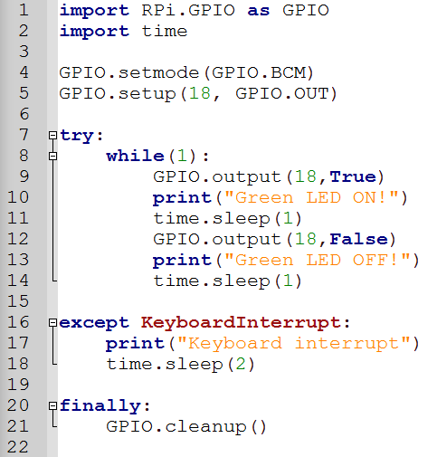
Programming a blinking LED

Slide 73
RPi Challenge 3
Can you program the LED to blink in sequence? Green, Yellow, Red, Green, Yellow Red, … (forever)

Slide 74
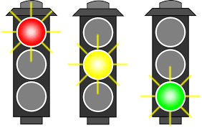
RPi Challenge 4
Can you use 6 LEDs to simulate a traffic light junction in real life? Green will be on for 20 secs, yellow for 2 secs, then red for (?) secs.

